Slide 1

Online Shop Management System
Section : 20
Course : CSE103
Group : 7
STUDENT ID​ ​ | NAME​
2024-3-60-416​ | Rijona Rahman Orthy​
2024-3-60-394​ | Sahidul Islam​
2024-3-60-417 | Mahdi Ahmed Khan
2024-3-60-719​ | Samir Sarower Anin​
Presented to:
Md. Ashraful Haider Chowdhury Lecturer Department of Computer Science and Engineering
​

Slide 2
Circle of Contents
1. Abstract
2. Introduction
3. Project Aim and Objectives
4. Flowchart
5. Program Output Screenshot
6. Source Code
7. Limitation of Program
8. Extra Features
9. Conclusion

Slide 3
Abstract
The Online Shop Management System is a comprehensive C program designed to facilitate the core operations of an e-commerce platform. The system provides distinct functionalities for two user roles: Admin and Customer. Admins can efficiently manage inventory, while customers can seamlessly browse and purchase products. This project highlights simplicity and efficiency in managing online store transactions while offering a user-friendly experience.

Slide 4
Introduction
In the era of digitalization, online shopping has become an integral part of daily life. This project addresses the need for a streamlined system to manage the basic functionalities of an online shop. The program provides solutions for inventory management and customer purchases, ensuring smooth operations. By incorporating features like admin authentication and product handling, this system sets the foundation for more advanced e-commerce solutions.

Slide 5
Project Aim and Objectives
Objectives
Aim
To develop a robust online shop management system leveraging C programming, ensuring simplicity and reliability in operations.
Establish a secure and reliable login system for Admin users.
Enable Admins to manage the product inventory through options to add, update, and view products.
Allow customers to browse available products and make purchases.
Create a straightforward and intuitive interface for users, minimizing errors and maximizing functionality.

Slide 6
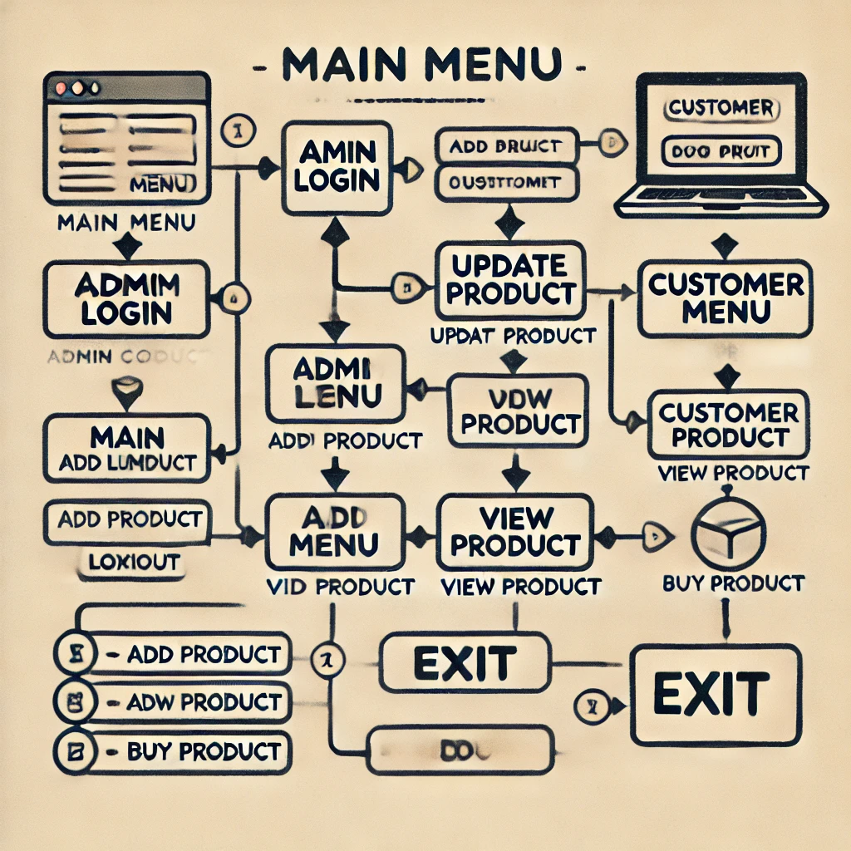
Flowchart
1. Main Menu: Provides options for Admin Login, Customer Menu, and Exit. 2. Admin Login: - Validates user credentials. - Grants access to the Admin Menu. 3. Admin Menu: - Add Product. - Update Product Quantity. - View Products. - Logout. 4. Customer Menu: - View Products. - Buy Product. - Return to Main Menu. 5. Exit: Terminates the program.

Slide 7
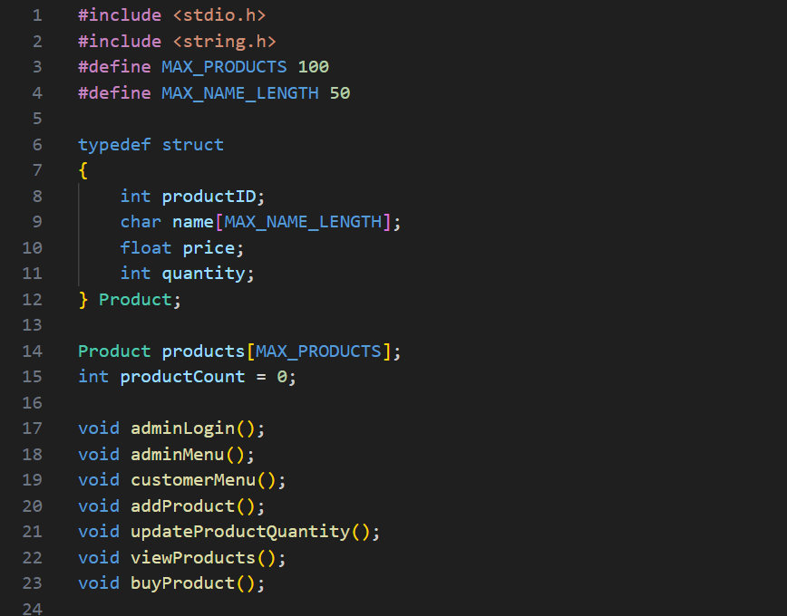
Source Code
Definition Area

Slide 8
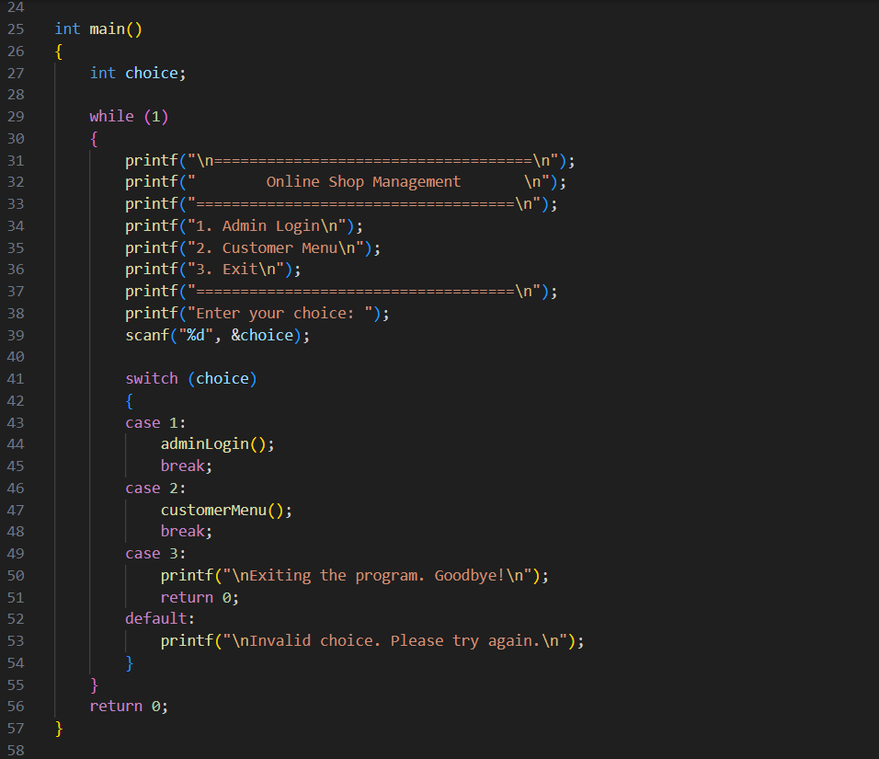
Main Function

Slide 9
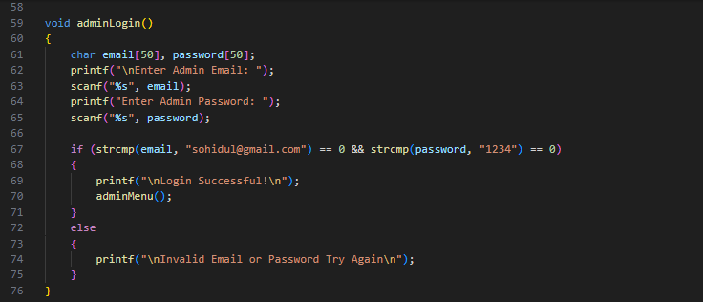
Admin login

Slide 10
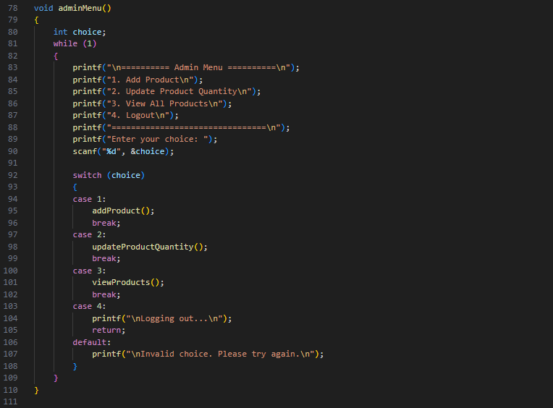
Admin menu

Slide 11
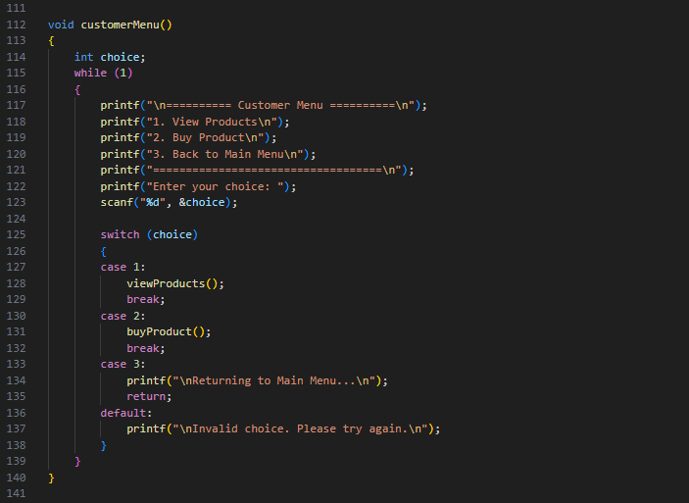
Customer Menu

Slide 12
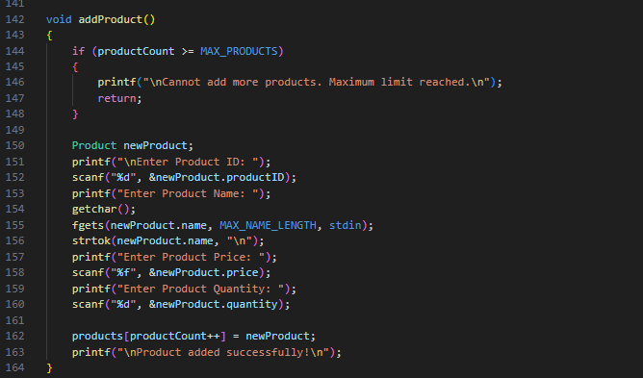
Add product

Slide 13
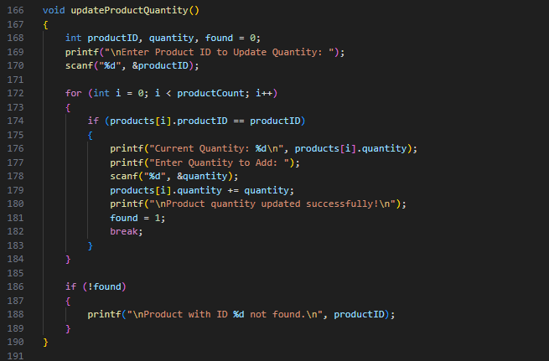
Update product and quantity

Slide 14
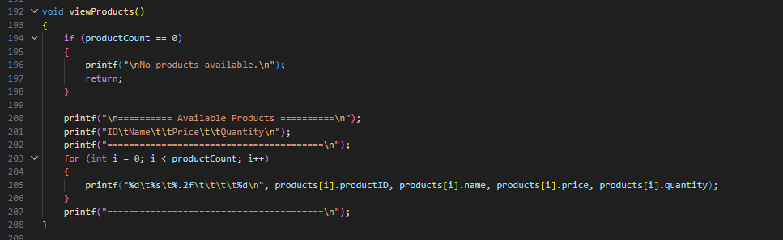
View products

Slide 15
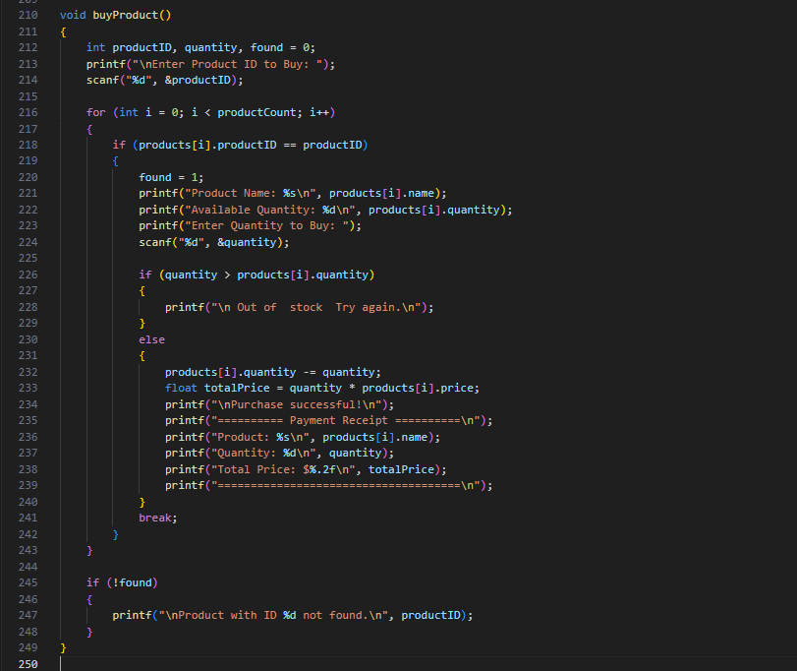
Buy product

Slide 16
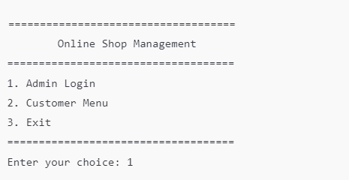
Program Output
Main Menu
The program shows the main menu and waits for the user's input.

Slide 17
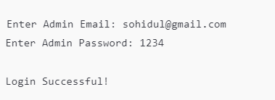
Program Output
Admin Login
The user enters the correct credentials and successfully logs in as an admin.

Slide 18
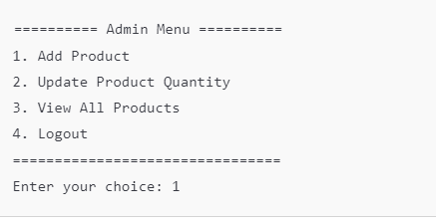
Program Output
Admin Menu
After logging in as an admin, the program displays the admin menu.

Slide 19
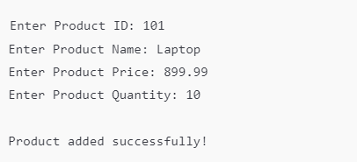
Program Output
Add Product
Admin adds a new product (Laptop) with ID, price, and quantity

Slide 20
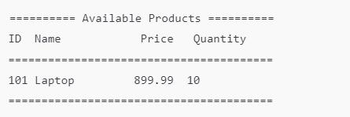
Program Output
View Products
Admin can view all products in the inventory.

Slide 21
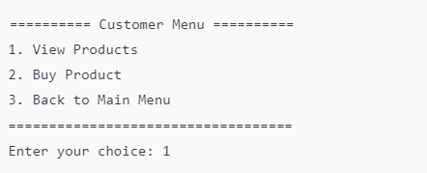
Program Output
Customer Menu
The customer chooses to view the products available.

Slide 22
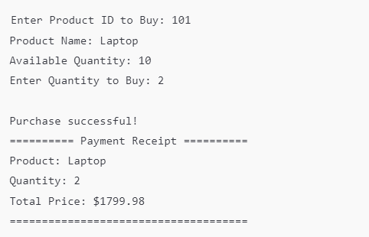
Program Output
Buy Product
The customer buys 2 laptops and receives a receipt with the total price.

Slide 23
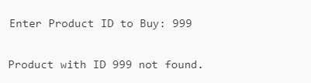
Program Output
Product Not Found
If the customer enters an invalid product ID, the system notifies them that the product was not found.

Slide 24
Limitation of Program
While the system successfully achieves its objectives, it has the following limitations:
No Data Persistence: Product data is not retained after the program exits.
Customer Authentication: Customers cannot create accounts or log in.
Error Handling: Input validations are limited, leading to potential misuse.
Search Functionality: Users cannot search for specific products by name or category.

Slide 25
Extra Features
Purchase Receipt: Customers receive a detailed receipt after a successful purchase.
Secure Admin Access: Admin credentials are verified for access to critical operations.
Dynamic Updates: Inventory quantities are updated in real-time based on transactions.

Slide 26
Conclusion
The Online Shop Management System demonstrates the effective use of C programming in solving real-world problems. By providing essential features for inventory management and product transactions, the system serves as a prototype for more complex e-commerce platforms. While there are areas for improvement, such as data persistence and enhanced user experience, the project successfully achieves its primary goals and offers a foundation for future advancements.

Slide 27
Thank you for your attention!

